Slide 1



CSS Animations
Frontend Frameworks
Lim Say Hao
Seiyial
in an era of

Slide 2
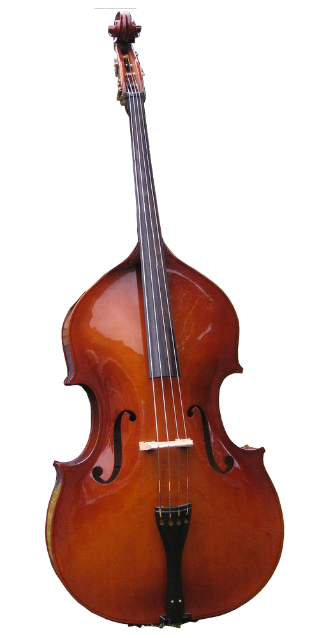











Define.self( )
Seiyial
Seiyial

